Slide 1
Welcome to BB2920: Genetics
Prof. Natalie Farny
1/13/2017
Lecture 2
RQ1 due Tuesday!
PS1 due Friday!

Slide 2
Today’s Learning Objectives (you will see these every day – use them to help you study! Ask yourself “Can I do these things?”)
Gain an overview of the three components of the study of genetics: genes, heredity, and biological variation
Understand and explain (with examples) the difference between forward and reverse genetics
Understand and explain (with examples) the difference between genotype and phenotype
Understand and explain (with examples) the two types of biological variation
Explore the role of environmental factors in affecting biological variation

Slide 3
Genetics: the study of genes, heredity and biological variation
isogenic
antimorph
phenotype
Genetics has its own unique vocabulary among biological disciplines. You will need to “talk the talk” to do well in this course. Your reading will help you!
linkage
genotype
pleiotropy
recombinant
codominance

Slide 4
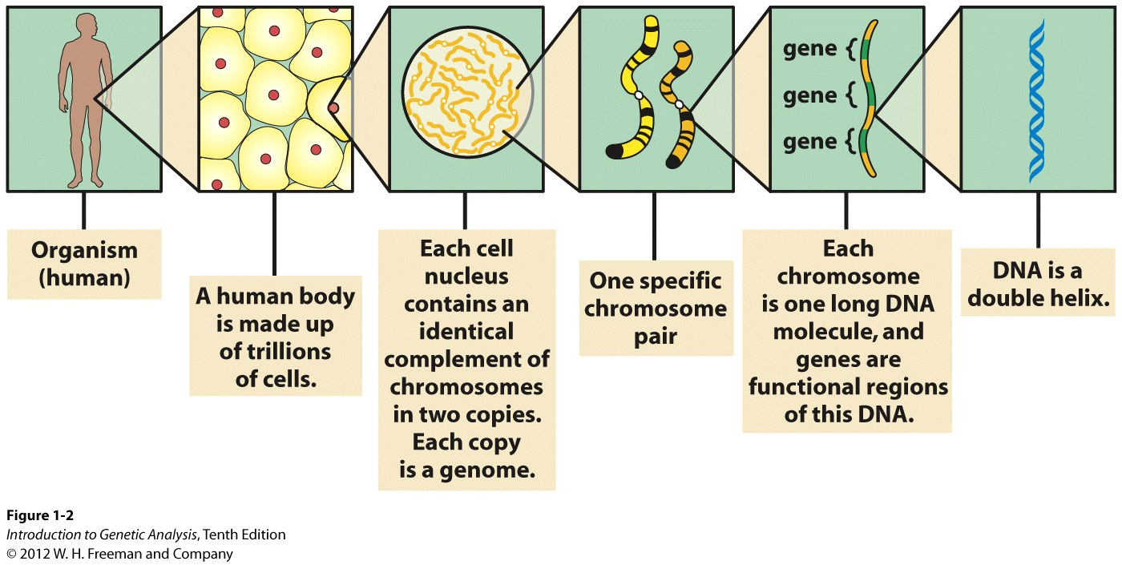
Genes are the functional units of DNA Each cell of an organism has the same complement of DNA

Slide 5
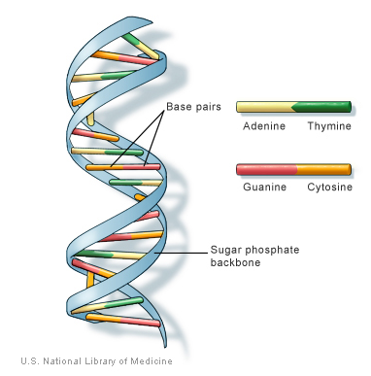
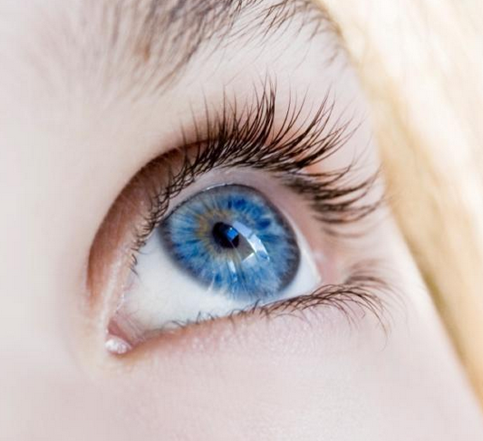
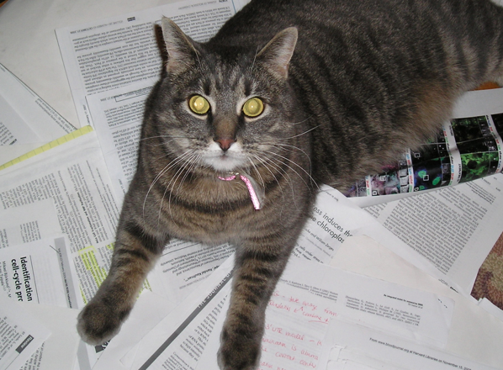
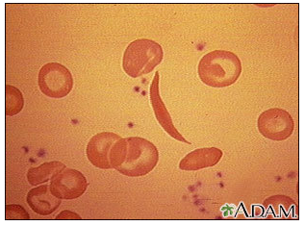
Genotype determines Phenotype
“genetic constitution”,
DNA sequence
outward or physical manifestation of the genotype
Genes come in different forms called alleles
Your alleles determine your phenotype
“wild type” – normal or most abundant phenotype
“found in the wild”
“mutant” – individuals with different or less frequent phenotype
1 gene = 1 protein
function

Slide 6
How do we determine gene function?
Forward genetics
identify a naturally occurring phenotype
map, isolate and identify the gene responsible
“phenotype to genotype”
Reverse genetics
Identify a gene of unknown function (genome sequence)
mutate the gene and look for a change in phenotype
“genotype to phenotype”
Both approaches utilize molecular genetics

Slide 7
Genetics: the study of genes, heredity and biological variation

Slide 8
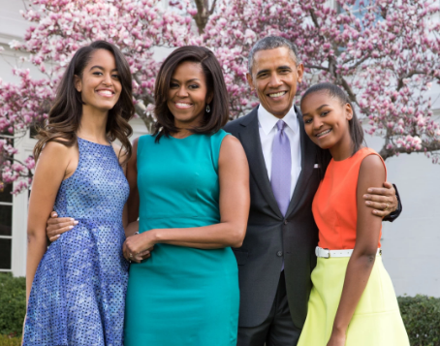
Heredity: the passing of “traits” from a parent to an offspring (traits = genes)
Why aren’t the daughters identical to the mother?
Why aren’t the daughters identical to each other?
Notes:
Why aren’t the girls identical to their mother? (because there is genetic input from the father)
Why aren’t the girls identical to each other? (because there is variation within an individual’s genetic input)

Slide 9
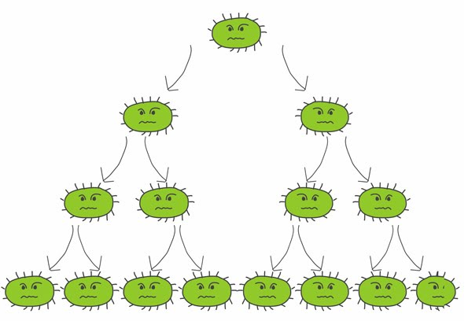
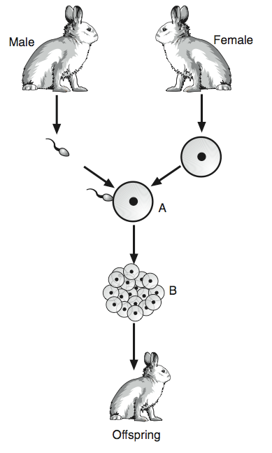
Heredity: the passing of “traits” from a parent to an offspring (traits = genes) – this is the process of reproduction
Asexual
Sexual
http://nat4biopl.edubuzz.org/
http://www.proprofs.com/quiz-school/upload/yuiupload/1829872254.jpg
Mitosis
Creates genetically identical offspring
Meiosis, then mitosis
Generates variation in a population
Notes:
Why aren’t the girls identical to their mother? (because there is genetic input from the father)
Why aren’t the girls identical to each other? (because there is variation within an individual’s genetic input)

Slide 10
Genetics: the study of genes, heredity and biological variation

Slide 11
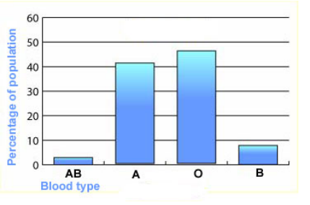
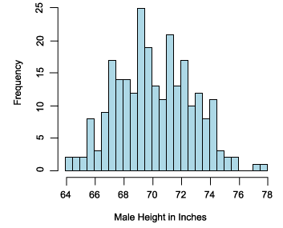
Types of Phenotypic Variation
Discontinuous:
distinct categories
tend to be controlled by one/few genes
http://www.biologymad.com/resources/RevisionM5Ch2.pdf
Continuous:
many states covering a range between two extremes
tend to be controlled by several/many genes (polygenic)
http://www.ibm.com/developerworks/library/wa-probab/
Notes:
Examples? Height (C), “handedness” (D), blood type (D), foot size (C), IQ/intelligence (C), inherited disease eg Cystic fibrosis (D), Autism (C).

Slide 12
What about a trait like IQ/intelligence?
Discontinuous
Continuous

Slide 13
What about a trait like “handedness” (dominance of one side of the body for performing particular functions)?
Discontinuous
Continuous

Slide 14
What about autism?
Discontinuous
Continuous

Slide 15
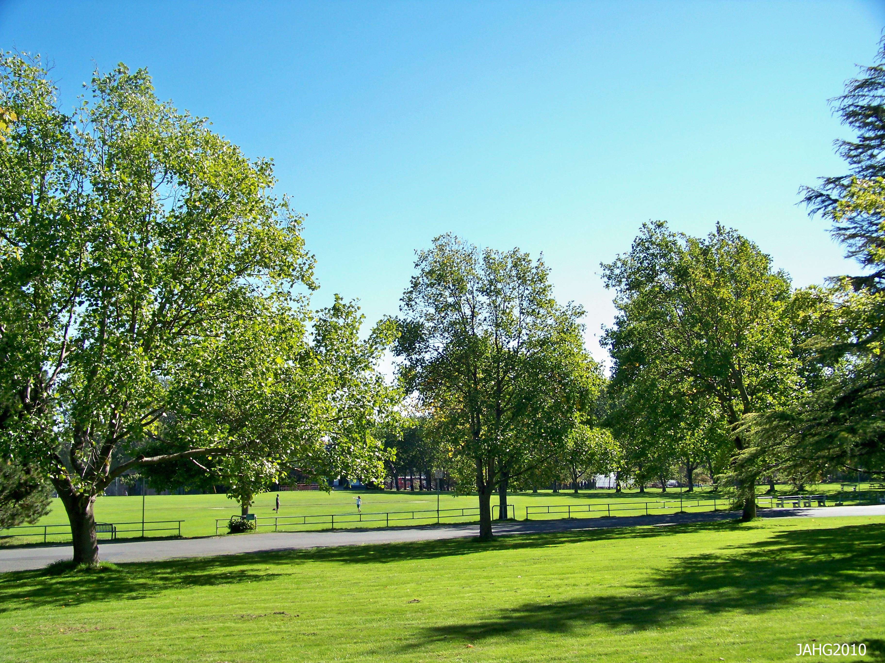




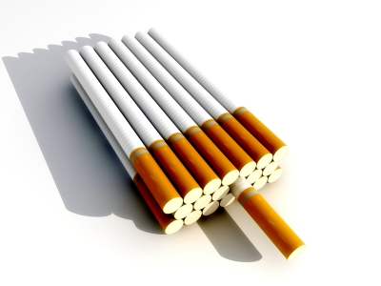
What about environmental influences on phenotype?

Slide 16
What is the role of the environment on phenotype? Can environmental factors affect your blood type?
Yes
No
Possibly / uncertain

Slide 17
What is the role of the environment on phenotype? Can environmental factors affect your height?
Yes
No
Possibly / uncertain

Slide 18
What is the role of the environment on phenotype?
Environmental factors tend not to affect discontinuous traits
Environmental factors can affect continuous traits

Slide 19
More Learning Objectives:
Understand the molecular structure and chemical properties of DNA
Use your understanding of the molecular properties of DNA to make inferences about the composition of a DNA sequence

Slide 20
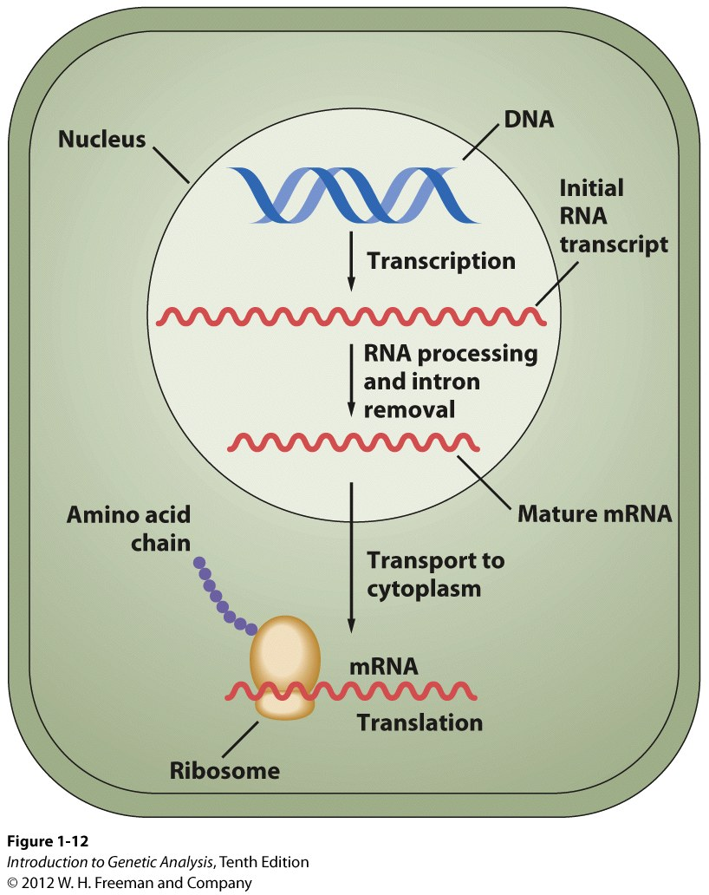
The Central Dogma of Molecular Biology
DNA
transcription
RNA
translation
Protein
replication

Slide 21
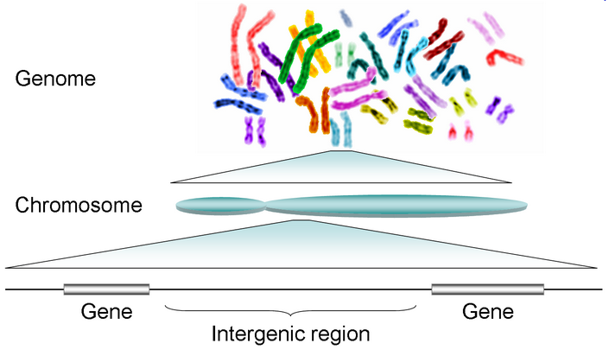
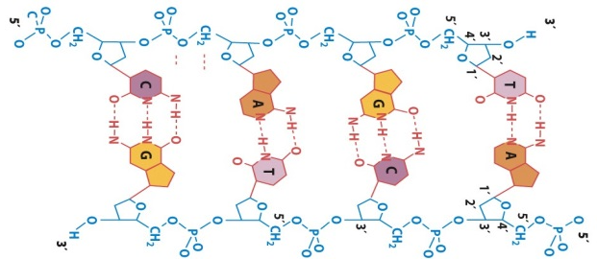
DNA, in the form of chromosomes, is the inherited genetic material
one complete copy of all the DNA of an organism
DNA

Slide 22
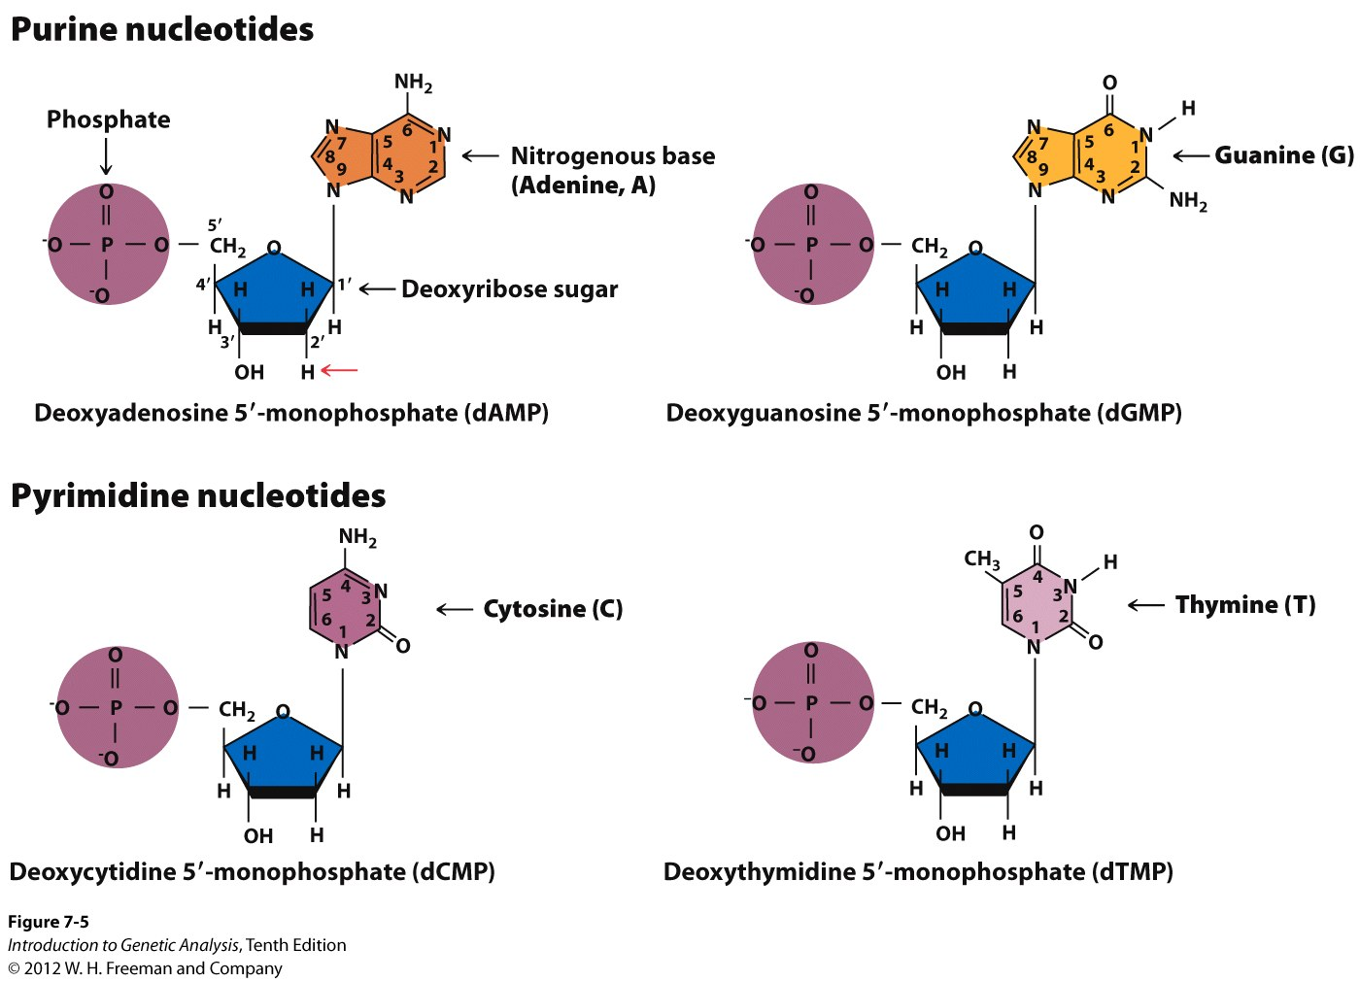
DNA is made of 4 nucleotides
deoxyribonucleic acid
1. phosphate (negative charge)
2. sugar (deoxyribose)
3. nitrogenous base
purine (A/G, double ring)
pyrimidine (C/T single ring)
Notes:
the chemical composition of DNA was known for many decades before its structure and its importance were understood

Slide 23

DNA Structure
Phosphodiester linkages (P attached on either side by O)
Antiparallel (5’→ 3’ linkage, running in opposite directions on different strands)
Phosphodiester bonds will only be formed on free 3’ ends of nucleotide chains!!!!!!! (Remember this! It will save you much heartache to come!)

Slide 24
Where could nucleotides be added to this DNA strand to make it longer?
1
2
1 and 2 only
2 and 4 only
1 and 3 only
3 and 4 only
All 4 positions
3
4

Slide 25
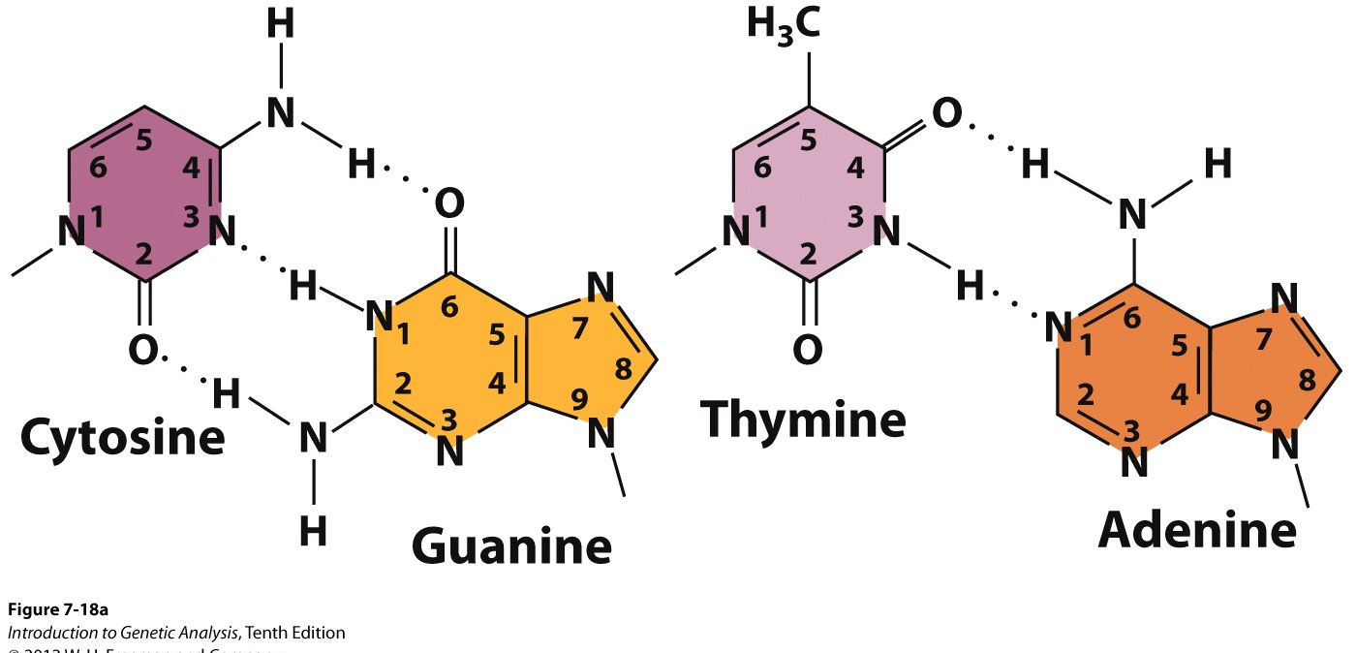
Hydrogen bonds connect base pairs
Complementary: Chargaff’s rules, Pyrimidine content = purine content (T = A; C=G)
Hydrogen bonds (C/G = 3, A/T = 2)
Think-Pair-Share: Why hydrogen bonds? (why not covalent bonds?)
H-bond has only 3% of the strength of a covalent bond
Notes:
only 3% of the strength of a covalent bond

